Slide 1
Software Analysis and Design (CS3004)
Course Instructor: Nida Munawar
Email Address: nida.munawar@nu.edu.pk
Lecture 4, 5 & 6

Slide 2
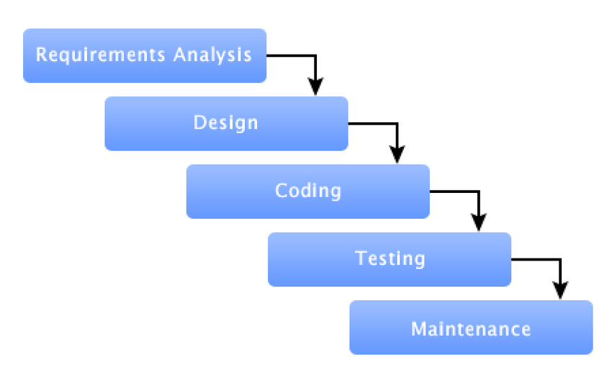
Software Process:

Slide 3

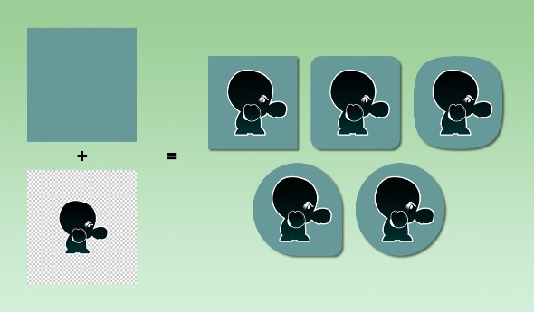
Software Development Models
Predictive VS Adaptive
Predictive
Adaptive

Slide 4
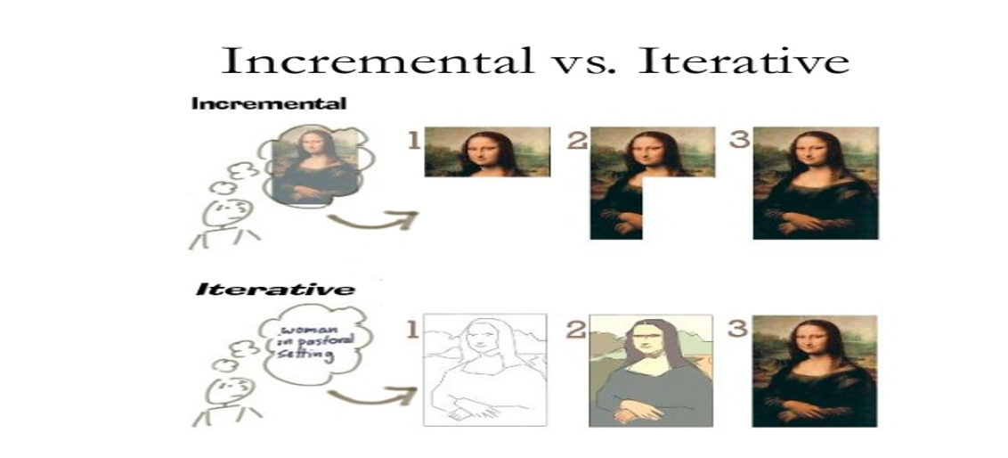
Software Development Models:

Slide 5
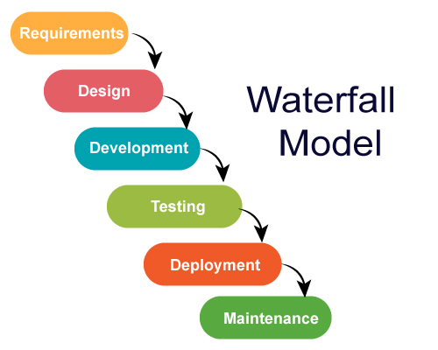
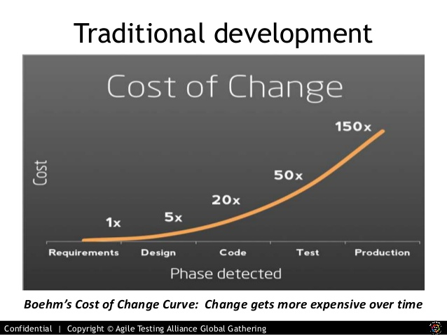
Traditional method
Assumptions:
Requirements are very well understood.
Team has experience building similar projects (like ATM Machine).

Slide 6
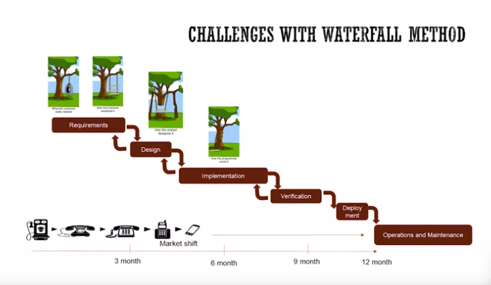
Challenges

Slide 7


Waterfall Model
Pros:
Easy to understand and simple
Predictable
Efficient
Cons:
Not flexible for change
First release take a long time
Use:
Repeated Project
For Predictable project
Good for small scale projects
Is it predictive or adaptive?
Predictive

Slide 8
Agile Manifesto:
We are uncovering better ways of developing software by doing it and helping others do it. Through this work we have come to value:
Individuals and interactions over processes and tools
Working software over comprehensive documentation
Customer collaboration over contract negotiation
Responding to change over following a plan
That is, while there is value in the items on the right, we value the items on the left more.”

Slide 9
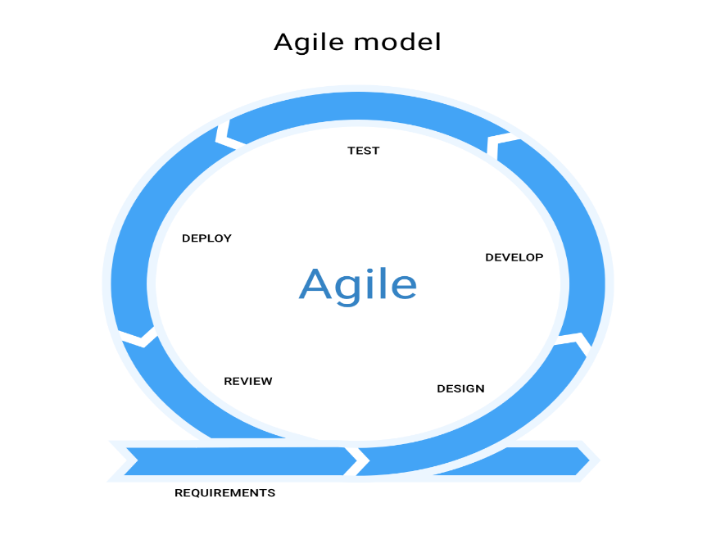
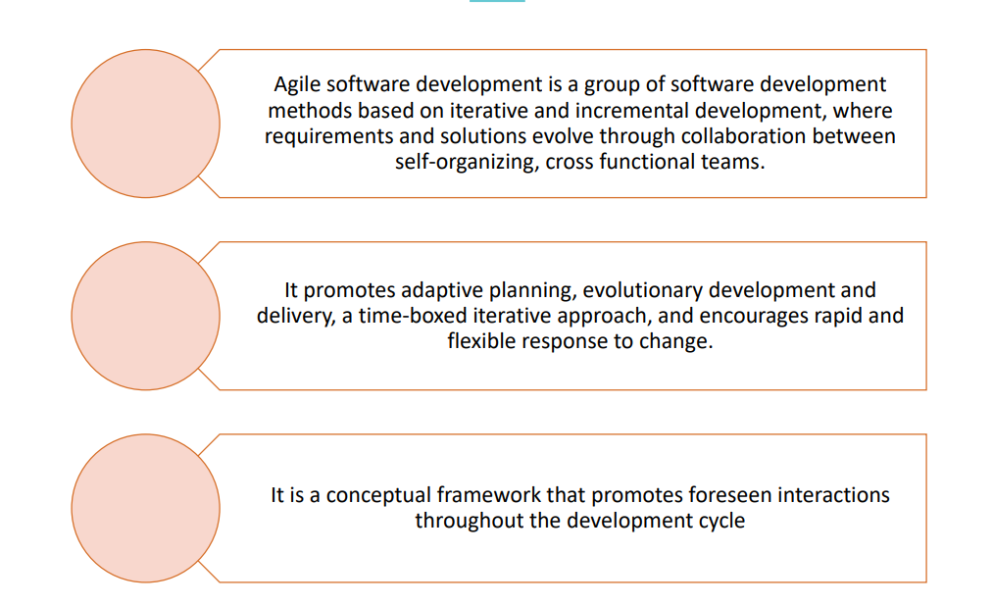
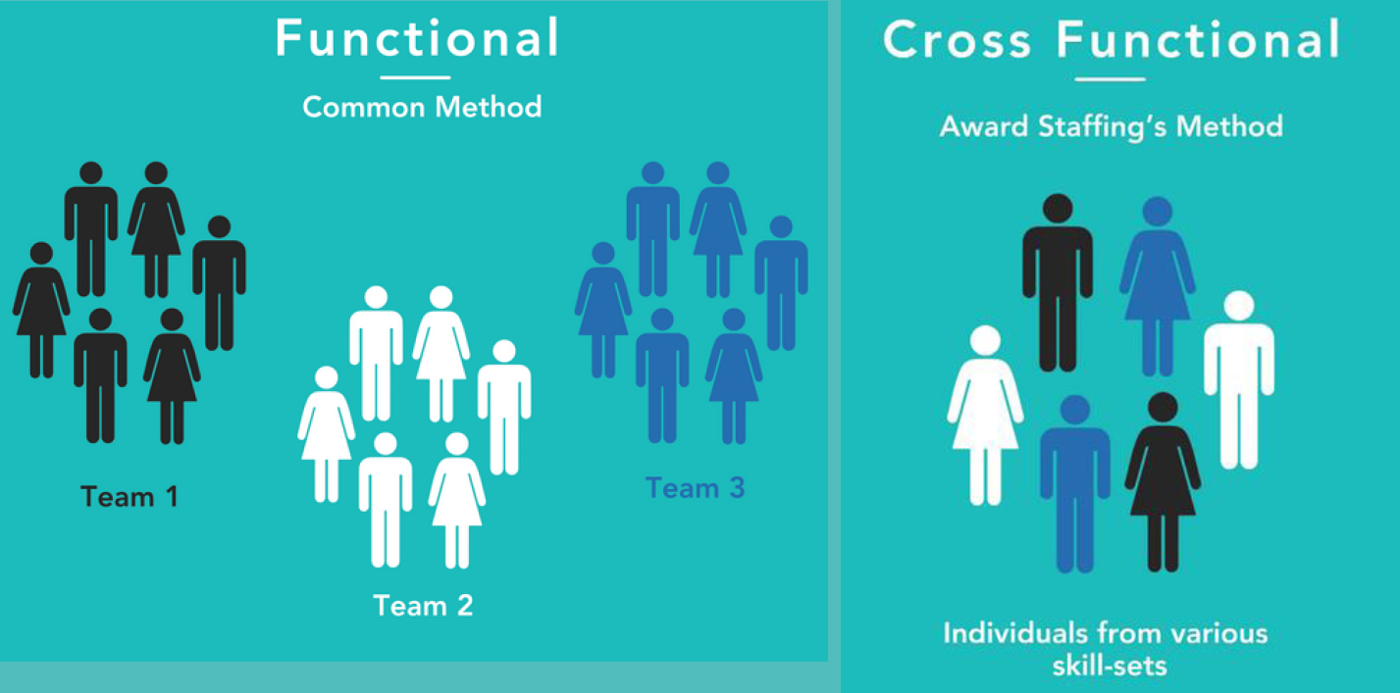
What is Agile?

Slide 10
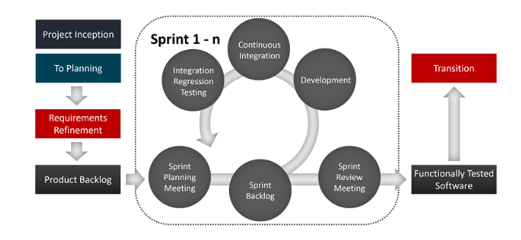
Adaptive: Agile Software Development Methodology

Slide 11
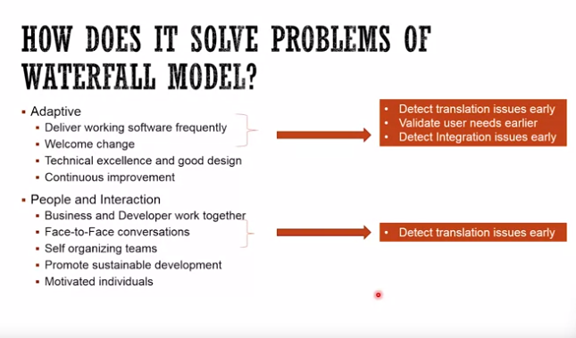
Adaptive: Agile Software Development Methodology

Slide 12
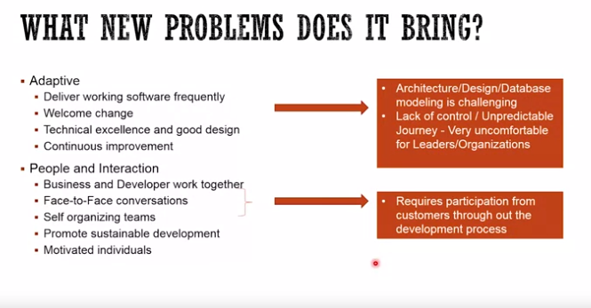
Adaptive: Agile Software Development Methodology

Slide 13
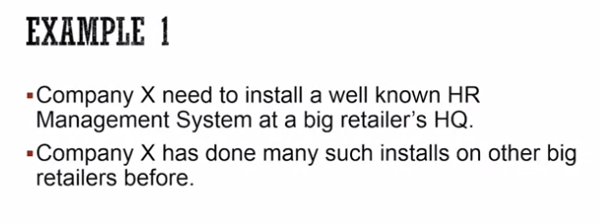
Task 1

Slide 14
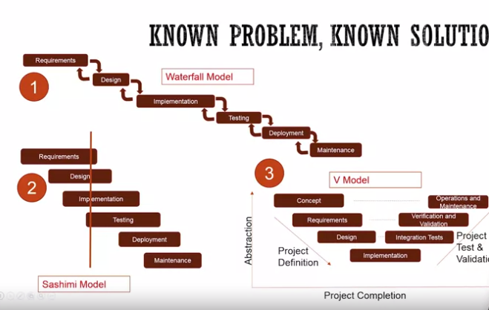
Solution

